Slide 1


CME 502- Mathematical Analysis and Modelling
Particle size distribution analysis in a Aluminium Metal Matrix Composites(MMC) reinforced with Glass Powder
Presented by –Ankita Mohanty
Date- 04/05/23

Slide 2
Contents
What is surface composite and FSP?
Microstructure
Importance of Particle distribution analysis in composites
Particle distribution study within the composites
Steps followed in writing the code
Results
Conclusion

Slide 3
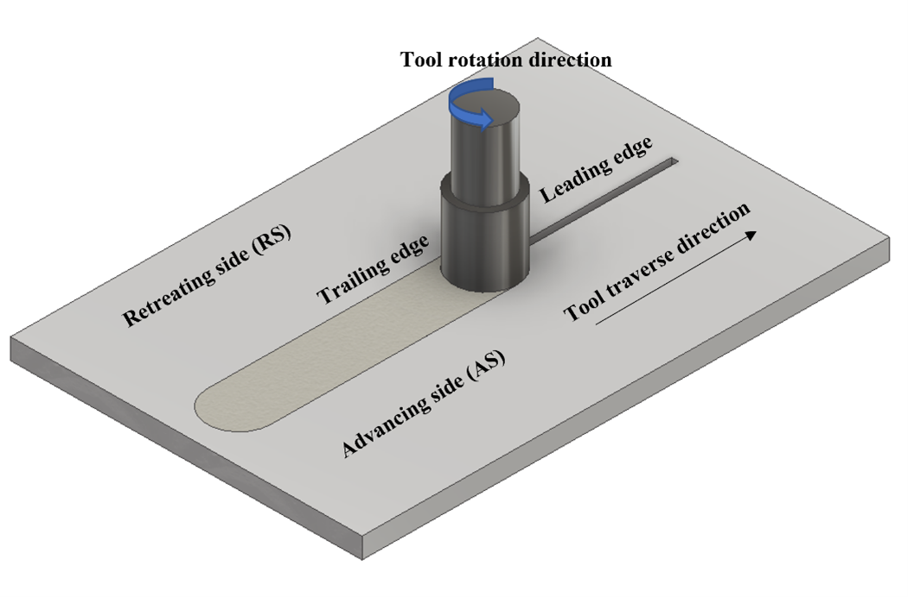
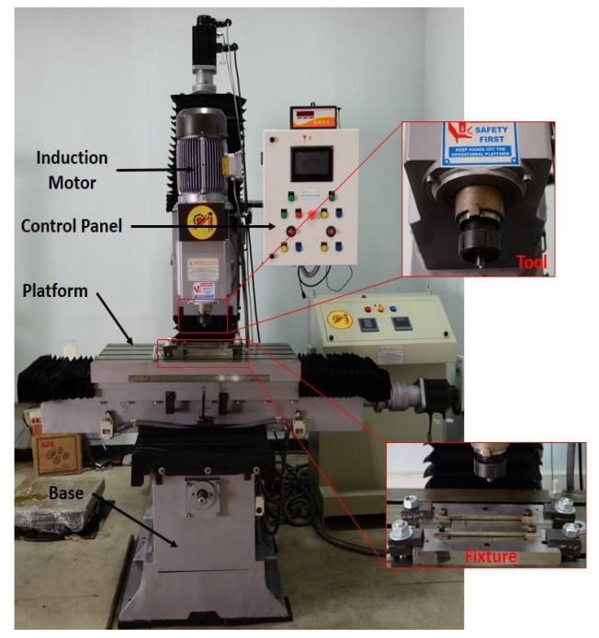
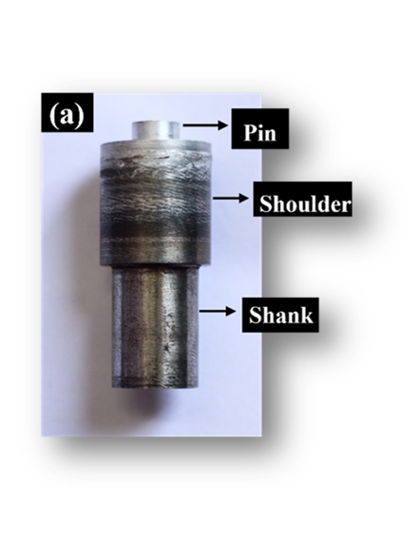
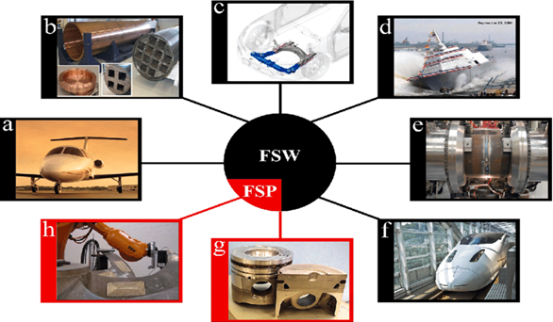
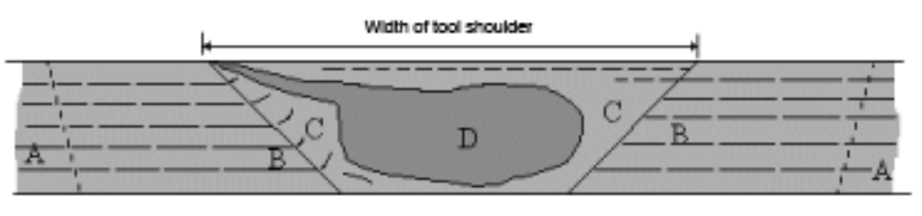
Surface Composites
Group of materials that possess superior properties on the surface without altering the properties of the base material.
Produced by incorporating one or more reinforcement elements into the matrix.
FSP, solid state processing can produce a surface composite.
Enhanced mechanical properties by dynamic recrystallization.
RS- Retreating side
AS- Advancing side
SZ- Stir Zone
Schematics of FSP/FSW
RS
AS
SZ
Various microstructural zones in FSW/FSP
Mistry, Jitendra M. et al., Science and Engineering of Composite Materials, 2018.

Slide 4
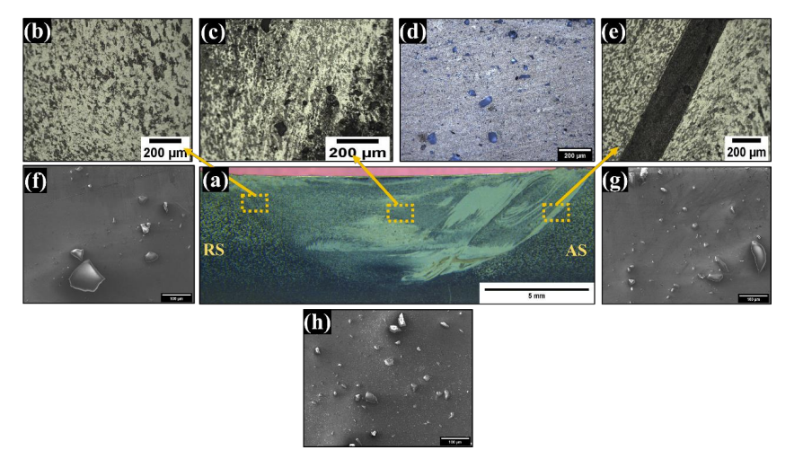
Microstructure
It is clear from the microscope images that the reinforcement dispersion is different in all three regions- AS, RS, and SZ.
Python code may be used to get an idea about the dispersion of the particles in three different regions.
Cross-section of GP 780 a) Macro image of the top surface of the processed zone, c) Stir zone, b) and e) TMAZ, RS and AS respectively d) OM image of particle reinforcement on the SZ, f, h g) SEM image of RS, SZ and AS respectively

Slide 5
Importance of Particle distribution analysis in composites
More particles better mechanical properties -hardness and wear properties.
1xxx aluminum alloys: poor hardness and wear properties- Glass: hard; improves it.
Non-shearable hard particles offer strength to the matrix and aid in hindering the dislocation movement.
Particle dispersion improves dislocation pinning effects, which will enhance the hardness.
Secondary particles act as load barriers and are effective in reducing plastic deformation. The presence of reinforcement particles reduces direct contact between the metal and the counterpart.
Parameters
In this, the effect of tool rotation speed on the particle distribution in various zones were compared. The parameters chosen were-
Tool Rotational Speed (rpm) | 600, 780, 900
Abbreviation | GP- Glass powder
Processing condition | GP600(AS,RS and SZ) GP780(AS,RS and SZ), GP900(AS,RS and SZ)

Slide 6
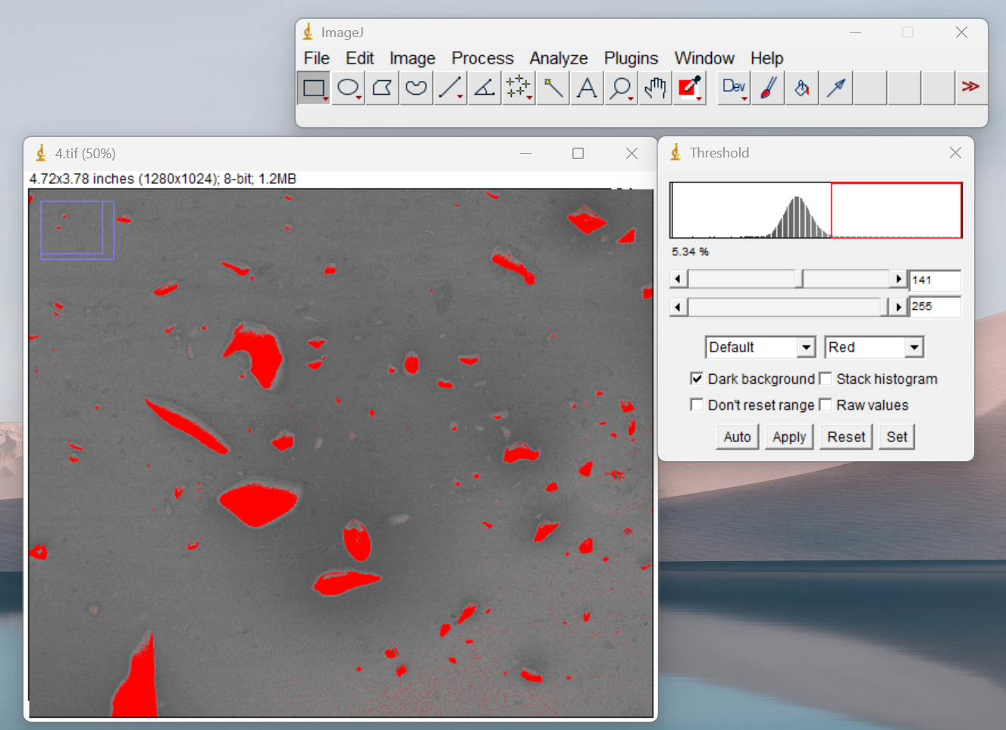

How Particle distribution can be studied within the composites?
SEM image
ImageJ
Python
code
SEM Image
The SEM micrograph is thresholded and converted into an 8-bit black and white image and saved in some folder.
SEM Image thresholded using Imagej
Black and white image

Slide 7
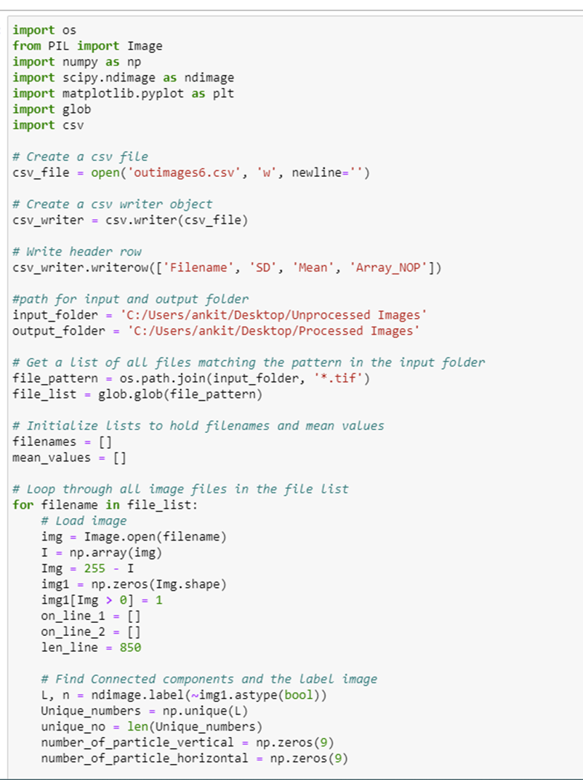
Steps followed in writing the code
SEM image
ImageJ
Python
code
This code processes a set of TIFF image files, extracting features from them and saving the results in a CSV file:
Imports libraries: The code imports several Python libraries at the beginning of the script. These libraries include os, PIL, numpy, scipy.ndimage, matplotlib.pyplot, glob, and csv.
Create a CSV file
Specifies the input and output folders: The code specifies the input and output folders for the TIFF image files using the variables 'input_folder' and 'output_folder'.
Finds TIFF image files: The code finds all the TIFF image files in the input folder using the glob.glob() function. It creates a file list containing the filenames of all the TIFF image files.
Loop through each TIFF image file: The code loops through each TIFF image file in the file list. For each file, it performs the following operations:
Notes:
Creating a CSV file: The code creates a new CSV file using the open() function and the 'w' mode. It then creates a csv writer object using the csv.writer() function and specifies the delimiter for the CSV file as a newline. Finally, it writes a header row to the CSV file containing the column names 'Filename', 'SD', 'Mean', and 'Array_NOP'.

Slide 8
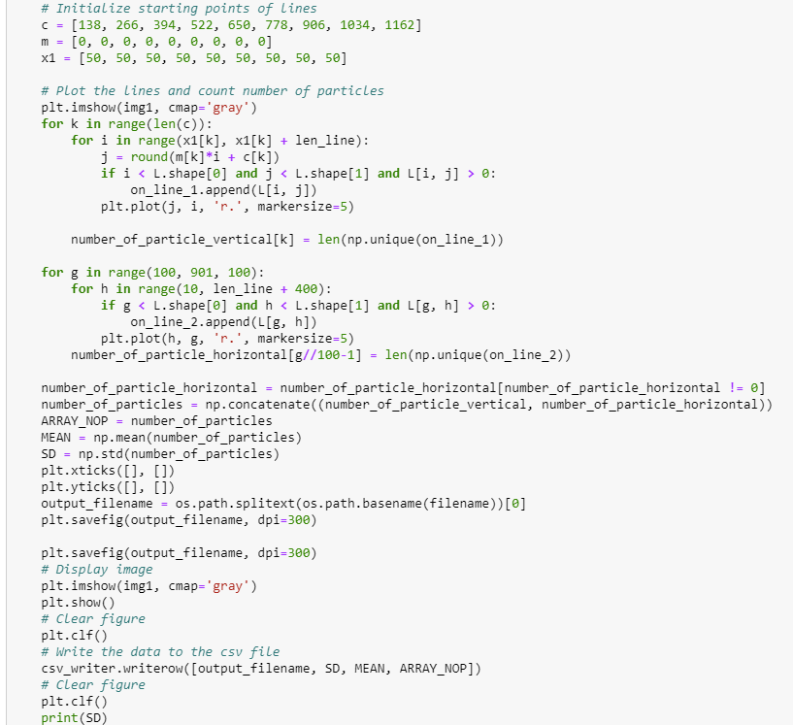
Steps followed in writing the code
.
SEM image
ImageJ
Python
code
a. Load image: The code loads the image using the Image.open() function and converts it to a numpy array using np.array().
b. Create binary image: The code creates a binary image from the inverted image by setting all non-zero values to 1 using the expression 'img1[Img > 0] = 1’.
c. Find connected components: The code uses the ndimage.label() function to find connected components in the binary image. It then finds the number of unique connected components and their labels.
d. Count particles: The code counts the number of particles along nine vertical lines and ten horizontal lines on the image
Notes:
Count particles- It uses the labels of the connected components to count the number of particles that intersect each line. It then calculates the mean and standard deviation of the total number of particles.

Slide 9
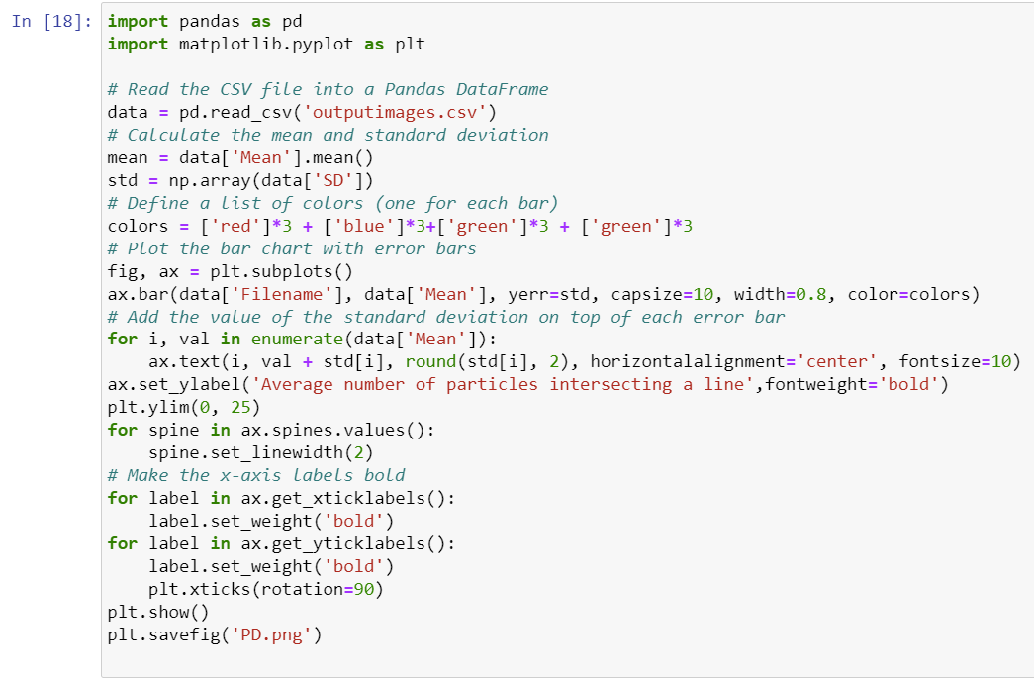
Steps followed in writing the code
SEM image
ImageJ
Python
code
f. Plot image: The code plots the image and the lines used to count particles using the matplotlib.pyplot library. It saves the image to the output folder using the filename of the original image file.
g. Write data to CSV file: The code writes the filename, mean, standard deviation, and the array of number of particles to the CSV file.
h. Clear figure: The code clears the matplotlib.pyplot figure to prepare for the next image.
Plotting of the bar graphs(Mean) with error bar
Read the CSV file into a Pandas DataFrame
Calculate the mean and standard deviation
Define a list of colors
Add the value of the standard deviation on top of each error bar
Make the x-axis labels bold etc….

Slide 10
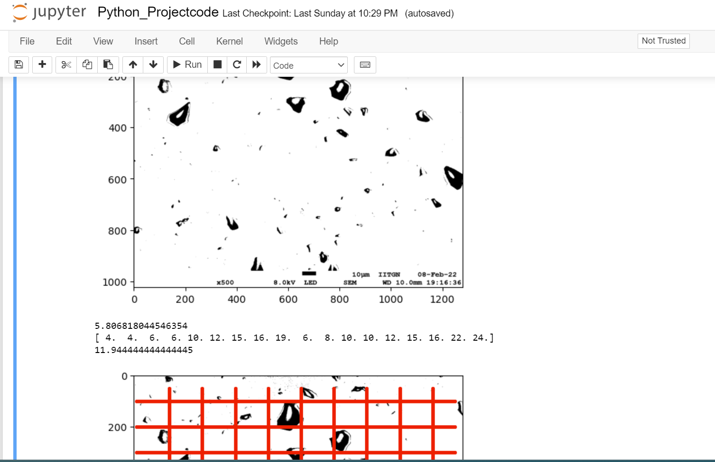
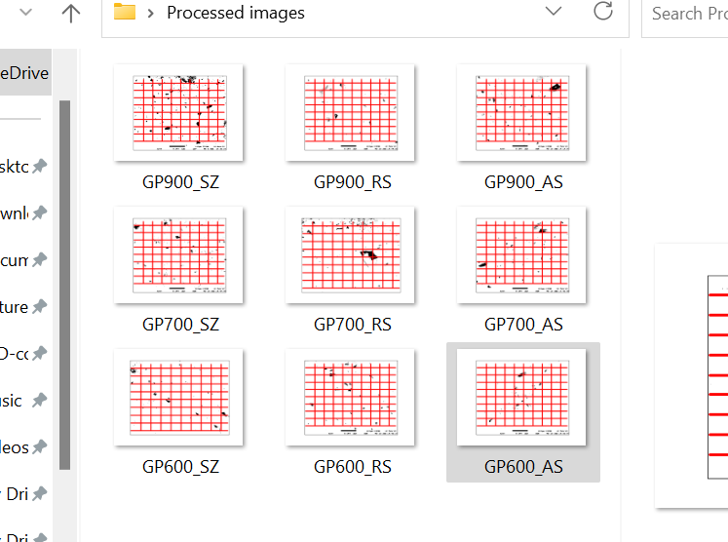
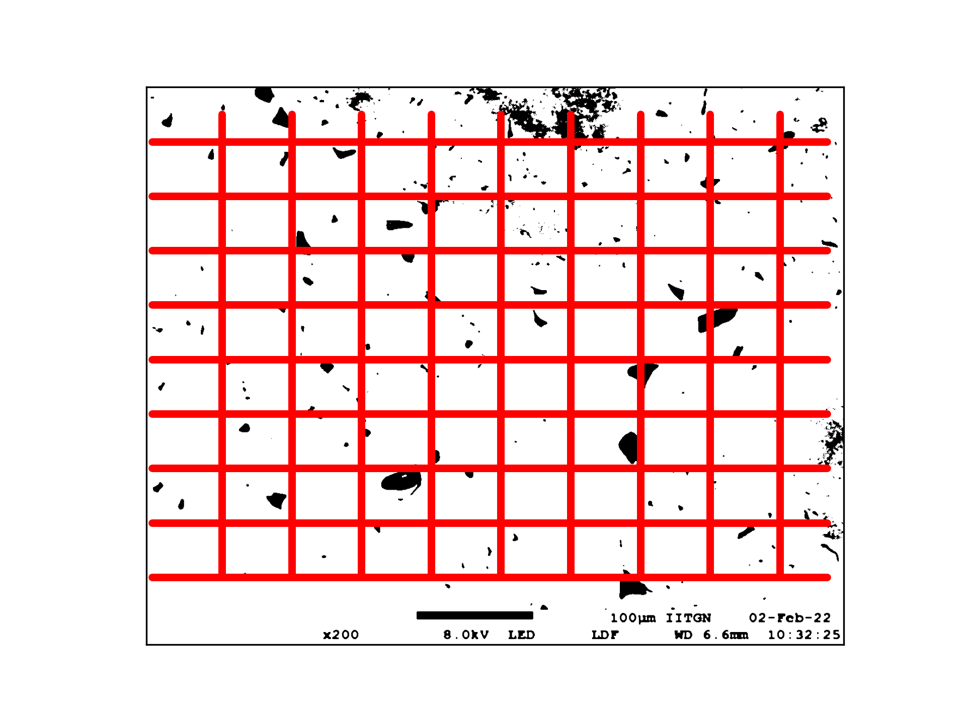
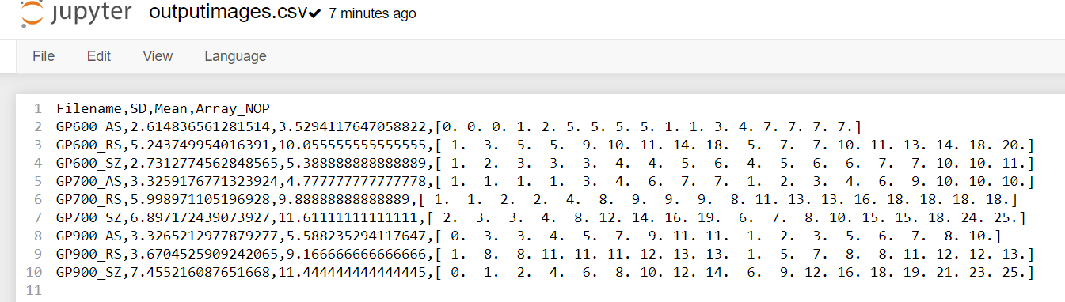
RESULTS
1
4
The code creates the grid and counts the number of particles intersecting per line, mean, and standard deviation and saves it in a CSV file.
The processed image is also saved in another output folder.
2
3

Slide 11
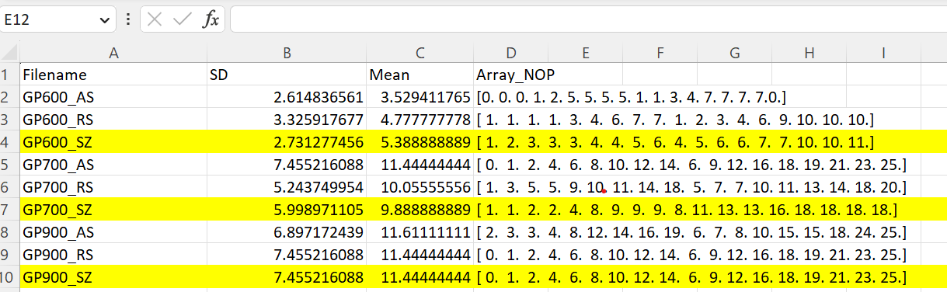
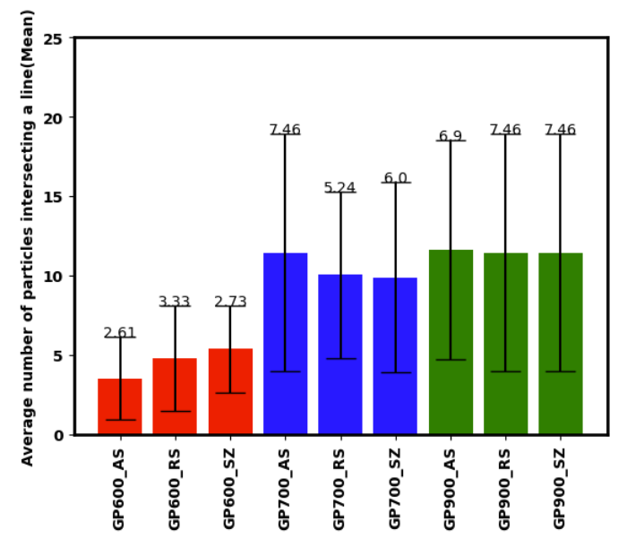
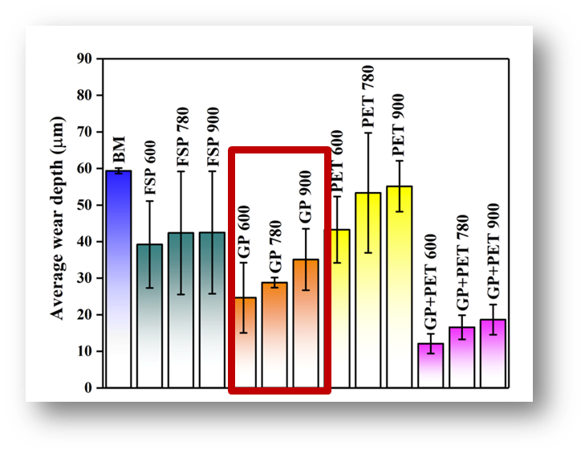
RESULTS
Mean estimation for centre SZ -GP900>GP780>GP600
With the increase in tool rpm- particle distribution in the SZ increases.
Reason for increased wear resistance for GP 900.
Less wear resistance for GP600 because less particles in the SZ
Particle analysis distribution of GP 600, GP 780 and GP 900 in three different regions

Slide 12
Conclusion
The python code can help in making an estimate how homogenously particles are distributed in the matrix.
Saves time-many images can be processed in a single run.
With the increase in tool rpm- particle distribution in the SZ increases-Shattering effect
Mean highlights the reinforcement particle distribution for each composite in various regions, and it is marked that the distribution is not uniform.
The standard deviation is high, suggesting the non-homogeneous dispersion of the particles in the various regions-meaning that the all the regions are not covered with glass particles.
Future work
Further work on improving the code so that the SEM image thresholding is also done using python code instead of using Imagej software

Slide 13
THANK YOU

Slide 14
ADDITIONAL SLIDES

Slide 15
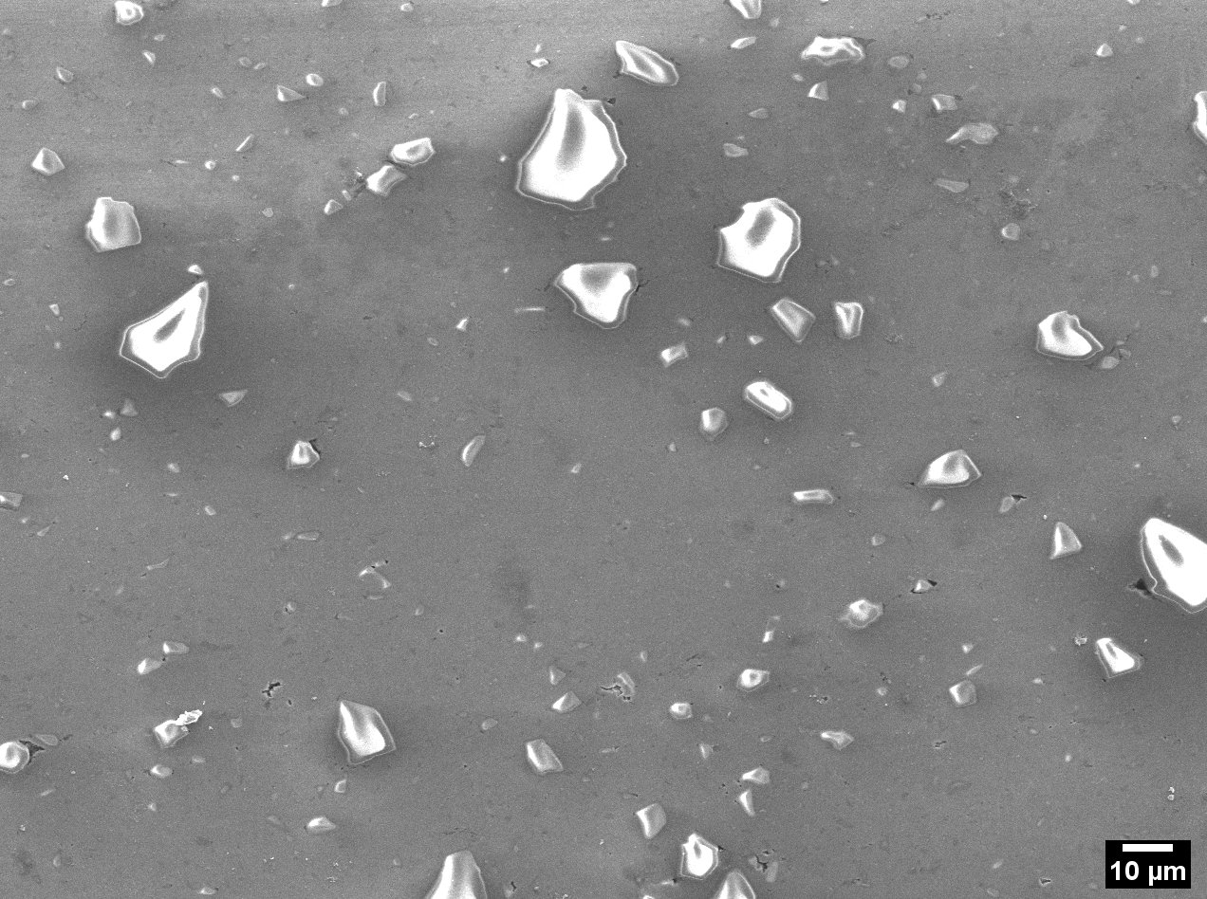
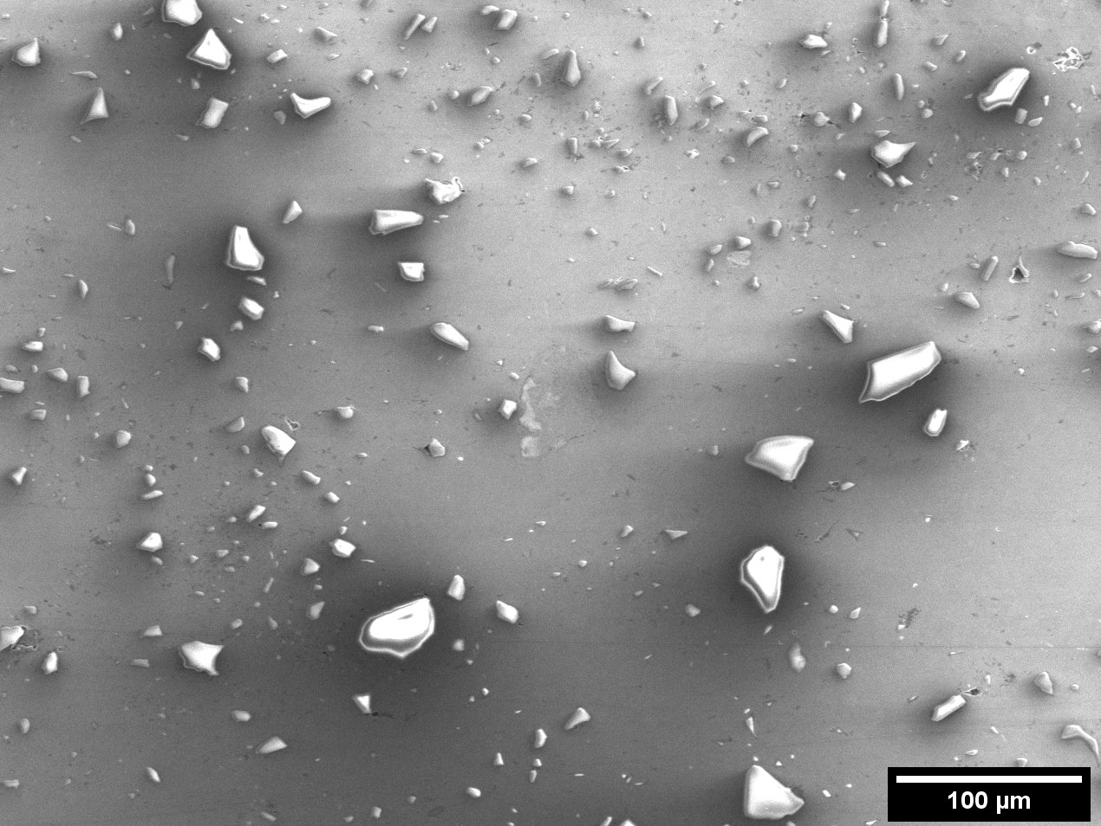
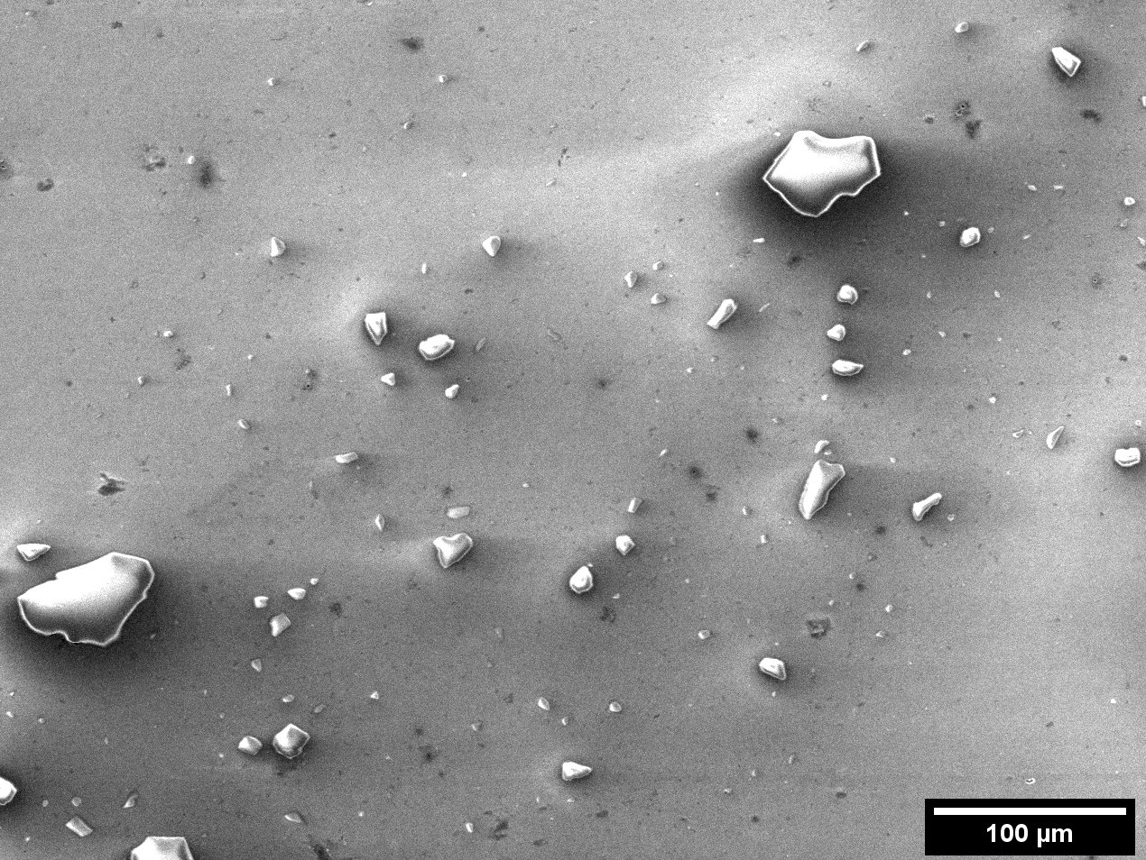

Slide 16
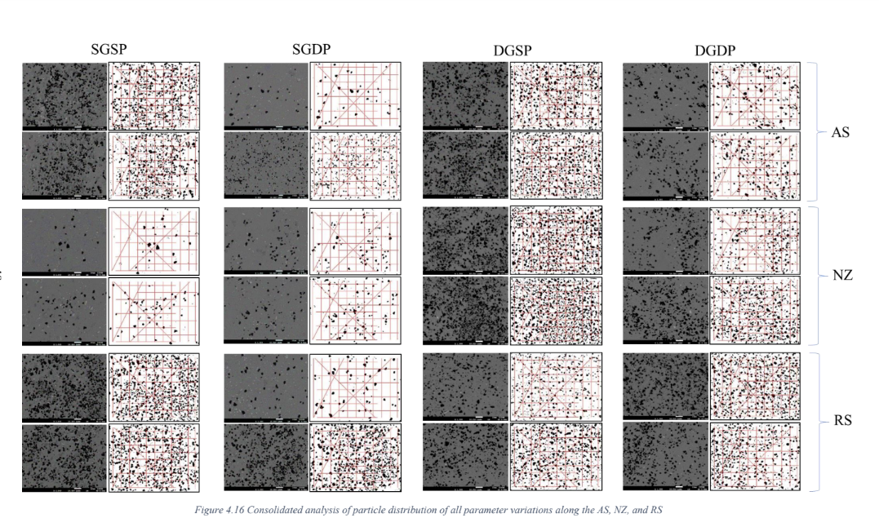

Slide 17
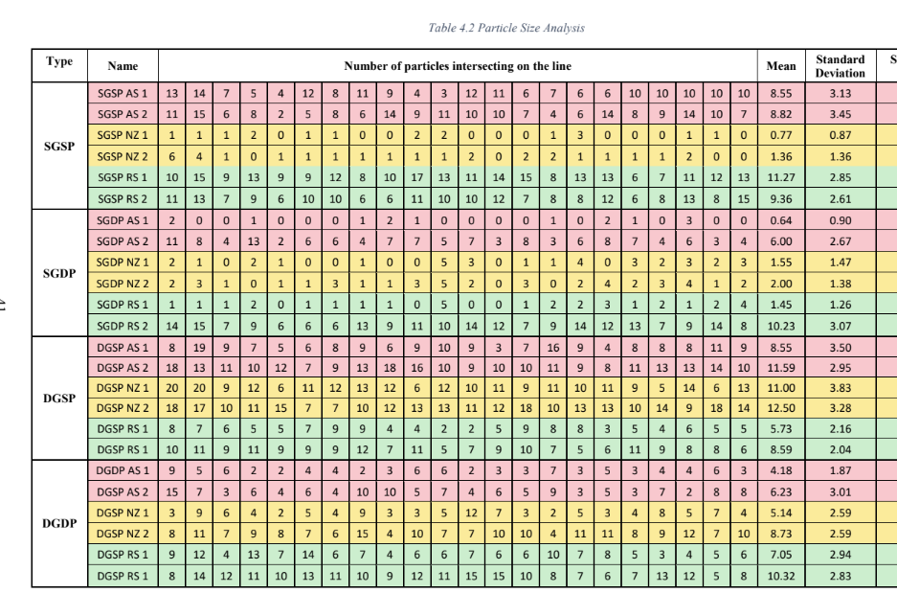
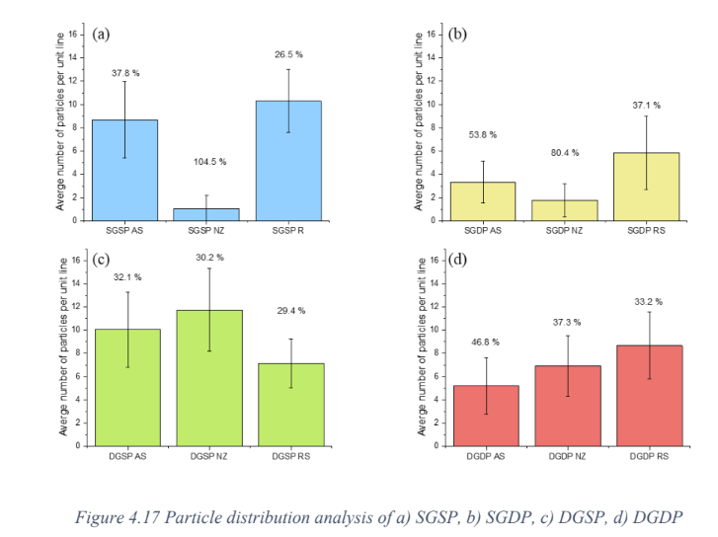

Slide 18
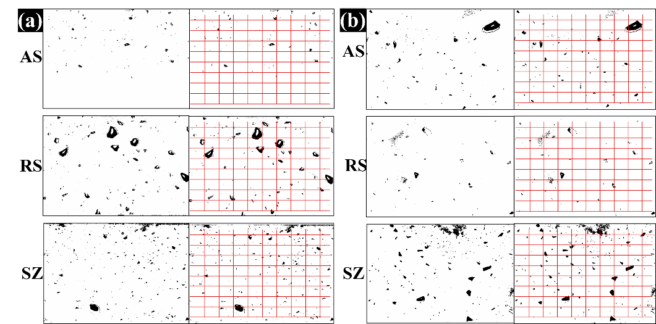
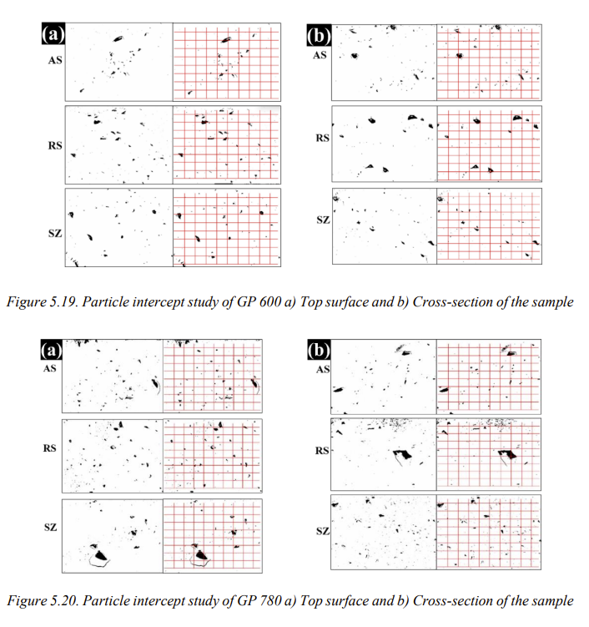

Slide 19
CODE DESCRIPTION
for filename in file_list:
This code initiates a loop that will iterate over all of the files in the file list. The variable 'file_list' would need to be defined earlier in the code.
img = Image.open(filename)
I = np.array(img)
Img = 255 - I
img1 = np.zeros(Img.shape)
img1[Img > 0] = 1
This code loads the image file specified by 'filename', converts it to a numpy array, inverts the color of the image and creates a binary image by setting all non-zero pixels to 1. the line Img = 255 - I inverts the colors of the input image. The reason for doing this is that the image is then thresholded by setting all non-zero pixel values to 1 using img1[Img > 0] = 1, which results in the particles being represented by white pixels on a black background. This makes it easier to identify and count the particles using the ndimage.label function, which assigns a unique integer label to each connected component in the binary image. If the image were not inverted, the particles would be represented by black pixels on a white background, which would make it more difficult to identify and count them.
L, n = ndimage.label(~img1.astype(bool))
Unique_numbers = np.unique(L)
unique_no = len(Unique_numbers)
This code uses the ndimage.label function from scipy.ndimage to identify connected components in the binary image. It then counts the number of unique connected components.
number_of_particle_vertical = np.zeros(9)
number_of_particle_horizontal = np.zeros(9)
This code initializes two numpy arrays, 'number_of_particle_vertical' and 'number_of_particle_horizontal', each with 9 elements.
c = [138, 266, 394, 522, 650, 778, 906, 1034, 1162]
m = [0, 0, 0, 0, 0, 0, 0, 0, 0]
x1 = [50, 50, 50, 50, 50, 50, 50, 50, 50]
This code initializes three arrays, 'c', 'm', and 'x1', each with 9 elements. These arrays will be used to plot lines on the image and count the number of particles that intersect each line.

Slide 20
The reason the image is inverted using Img = 255 - I in the provided code is to convert it from a black particles on a white background to white particles on a black background.
This is because the code uses the ndimage.label function from the scipy.ndimage library to identify and count the particles in the image. This function works by identifying connected regions of non-zero values in a binary (black and white) image. By inverting the image, the particles become white and thus connected regions of non-zero values, which can be more easily identified and counted by the function.
If the image were not inverted, the particles would be represented by black pixels on a white background, which would make it more difficult to identify and count them. This is because the ndimage.label function identifies connected regions of non-zero values, which in the original image would be the background rather than the particles. Inverting the image effectively swaps the roles of the particles and the background, making it easier to count the particles.

Slide 21
In the given code, the Python Imaging Library (PIL) is used to load and manipulate image data. Specifically, the Image module of the PIL library is used to open image files in the TIFF format.
The glob and os libraries are used for file handling purposes.-
glob library is used to search for filenames that match a specified pattern according to the rules used by the Unix shell. In the code, it is used to get a list of all the .tif image files in the specified input folder using the glob.glob() method. This method returns a list of pathnames that match the specified pattern. The pathnames are obtained using os.path.join(), which joins the input folder path and the filename pattern.
os library is used to perform various operating system-related tasks such as reading or writing to files, creating directories, etc. In the code, it is used to join the input folder path and the filename pattern using os.path.join(). The os.path.basename() method is used to extract the filename from the path, and the os.path.splitext() method is used to split the filename into its base name and extension. The os.path.join() method is also used to specify the output folder path.

Slide 22
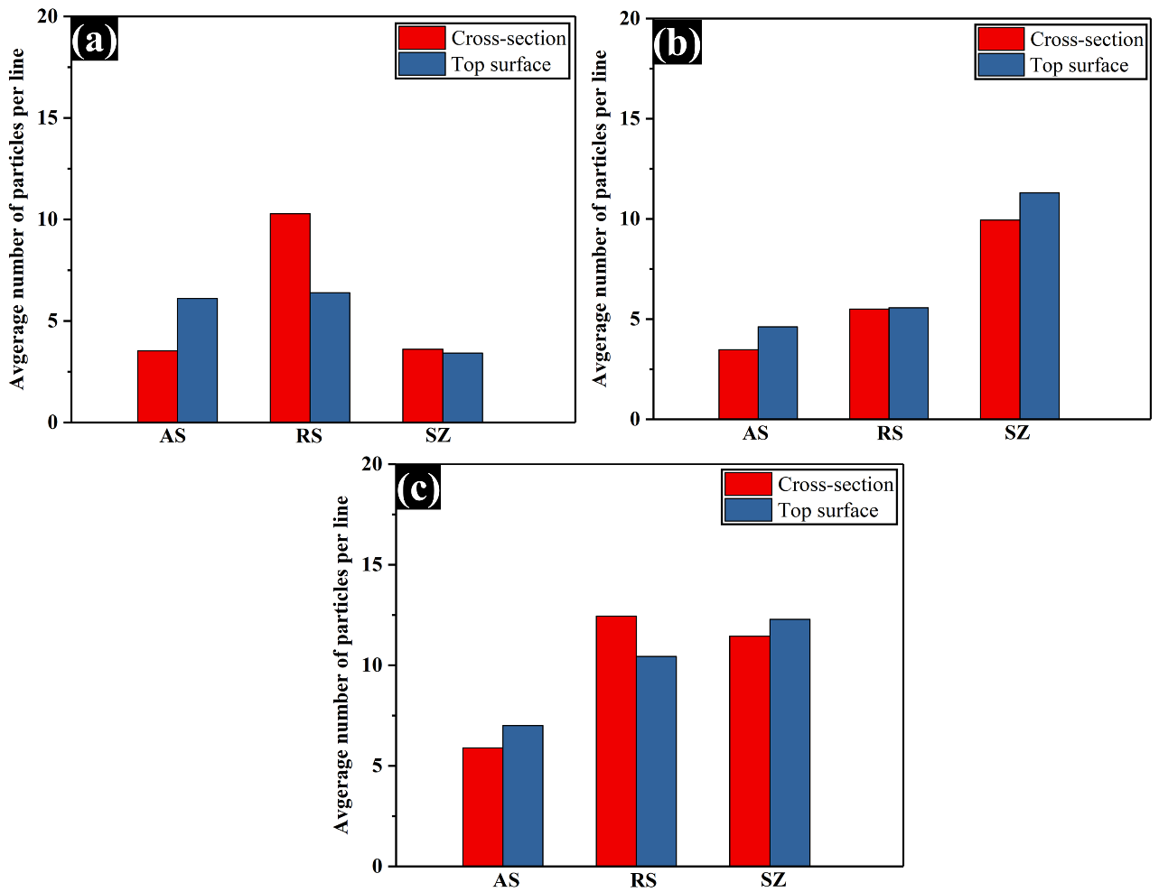
GP 600
GP 780
GP 900

